Slide 1
64-bit Kernel creating from Scratch
Submitted to,
Suman Saha
Lecturer,
Dept. of IRE, BDU
Submitted by,
Md. Rakib Hasan (1801047)
Md Tajbir Ahmed (2001046)
Shimul Mahmud Khatami (2001037)
25.05.2024

Slide 2
Topics:
Overview of the Project
Objectives
Environment Setup
Methodology
Command And Output
System key component and modules
Design and Implementation of the Basic File System
25.05.2024

Slide 3
Overview of the project
File Management.
Storage Management.
CPU Scheduling.
Basic I/O functions.
25.05.2024

Slide 4
Objectives
1.To incorporate the operating system's fundamental file management mechanism.
2. To Simple computation.
3.To Display the essential details, such as the time and date.
4. To manage the Tasks like memory, CPU, files, and directory .
25.05.2024

Slide 5



Environment Setup
Visual Studio
Cosmos
Vmware Workstation
25.5.24

Slide 6
Methodology
Step 1: Install & Setup Visual Studio and COSMOS
Step 2: Writing code in C#
Step 3: Run on VMware Workstation
25.5.24

Slide 7
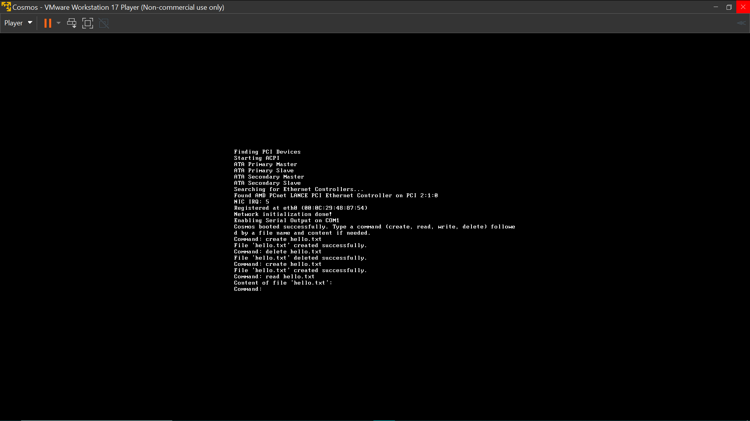
Before MID
25.05.2024

Slide 8
Command Implementation in the MID Portion
about : This command will show the current version of our OS.
date : This command will show the current date.
time : This command will show the current time.
day : This command will show the current day.
clear : This command will clear the console.
create_file : This command will create a text file.
write_file : By using this command we will able to write in a file.
append_file : By using this command we will able to add more text in an existing file.
25.5.24

Slide 9
To Be Continued…
show_file : This command will show the content of a file.
delete_file : This command will delete a file.
list_file : This command will show the list of all files.
create_directory : This command will create a directory.
current_directory : This command will show the current directory.
change_directory : This command will change the directory.
list_directory : This command will show the list of all directories.
delete_directory : This command will delete the directory.
back : By using this command we can back to the first directory.
CPU Scheduling: FCFS,RR
25.5.24

Slide 10
Command Implementation in Final Portion
Scheduling Algorithm:
fcfs_Scheduler : This command will apply the first come first serve scheduling.
RR_scheduler : This command will apply the Round Robin scheduling.
calculator : This command will give us a calculator to use.
shutdown : This command will shutdown our OS
25.5.24

Slide 11
Limitations
Don’t have any user interface.
Only works on FCFS and Round Robin algorithm.
Don’t have implemented process synchronization(Deadlock).
Does Not work on memory management.
25.5.24

Slide 12
Conclusion
The development of a basic file management and calculation operating system involves with efficient file management capabilities and robust calculation tools. By focusing on these objectives, we can create a system that empowers users to manage their files effectively, perform various calculations. Moreover, by continuous feedback we can improve this operating system.
25.5.24

Slide 13
References:
1.https://stackoverflow.com/questions/3892980/developing-for-both-64-bit-and-32-bit
2.https://www.geeksforgeeks.org/cpu-scheduling-in-operating-systems/
25.5.24

Slide 14
THANK YOU

